Slide 1
AngularJS
Using Controllers in Directives
Lecture 4
By James(Jin) Wang
08/08/2019

Slide 2
Outline
Using a Controller in a Directive
Replacing Link() with a Controller
Using controllerAs
Adding a Controller to TableHelper
Passing Parameters Out of a Directive
Understanding Transclusion

Slide 3
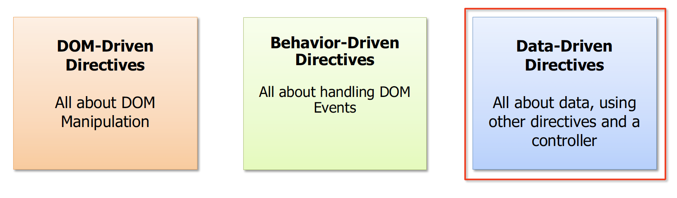
Using a Controller in a Directive
  Directive Categories

Slide 4
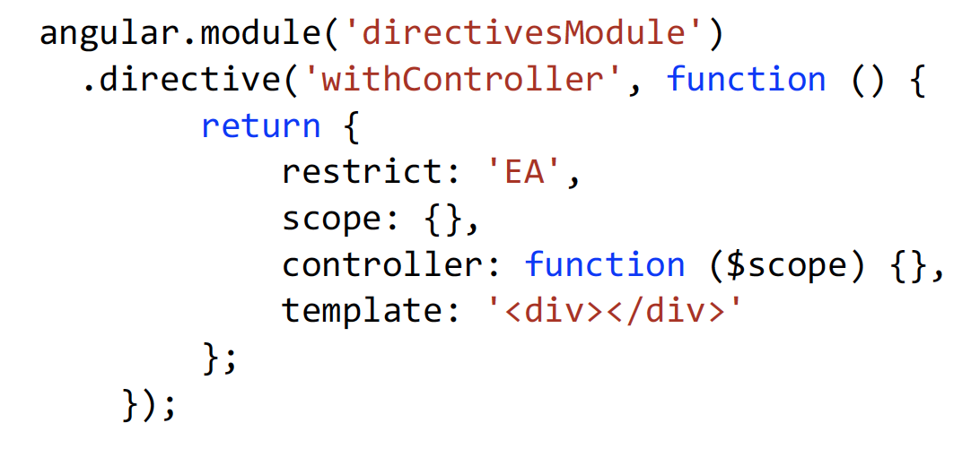
Using a Controller in a Directive
  Adding a Controller to a Directive

Slide 5
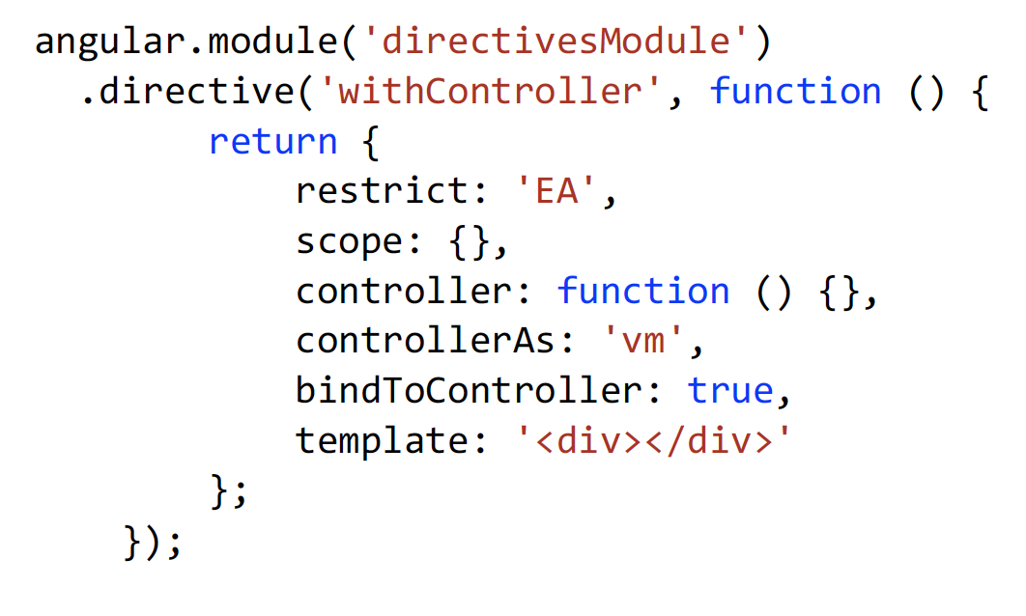
Using a Controller in a Directive
  Additional DDO Properties

Slide 6
Replacing Link() with a Controller
  Replacing Link() with a Controller
  Demo: Replacing link()

Slide 7
Using controllerAs
  Using controllerAs
  Demo: controllerAs

Slide 8
Adding a Controller to TableHelper
  Adding a Controller to TableHelper
  Demo: add controller to TableHelper

Slide 9
Passing Parameters out of a Directive
  Passing Parameters out of a Directive
  Demo: passing para out of a Directive

Slide 10
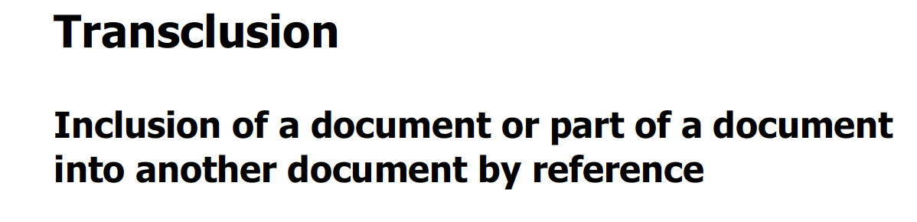
Understanding Transclusion

Slide 11
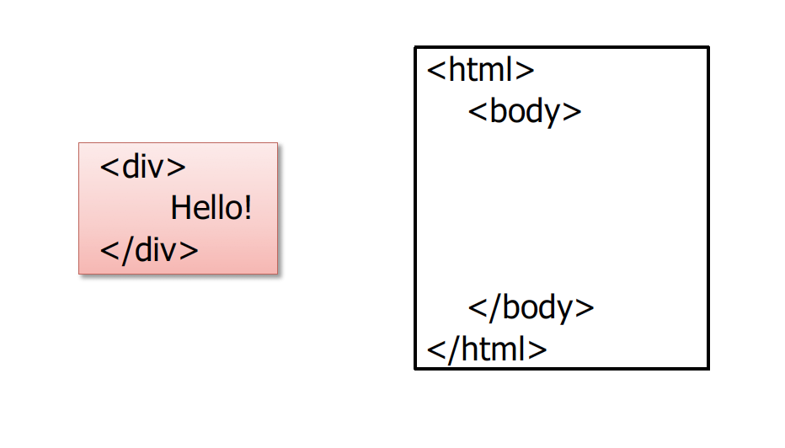
Understanding Transclusion
  Transclusion is Similar to Includes

Slide 12
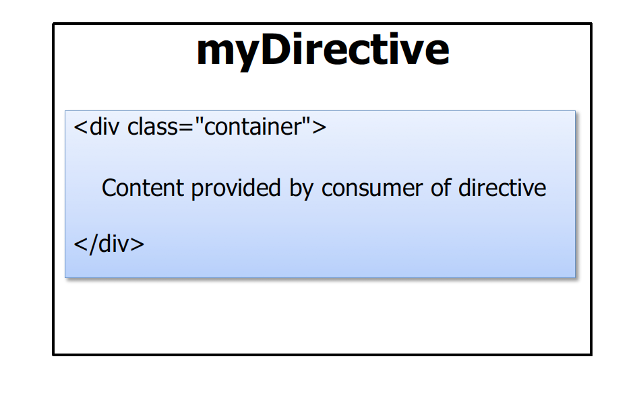
Understanding Transclusion
  Transclusion and Directives

Slide 13
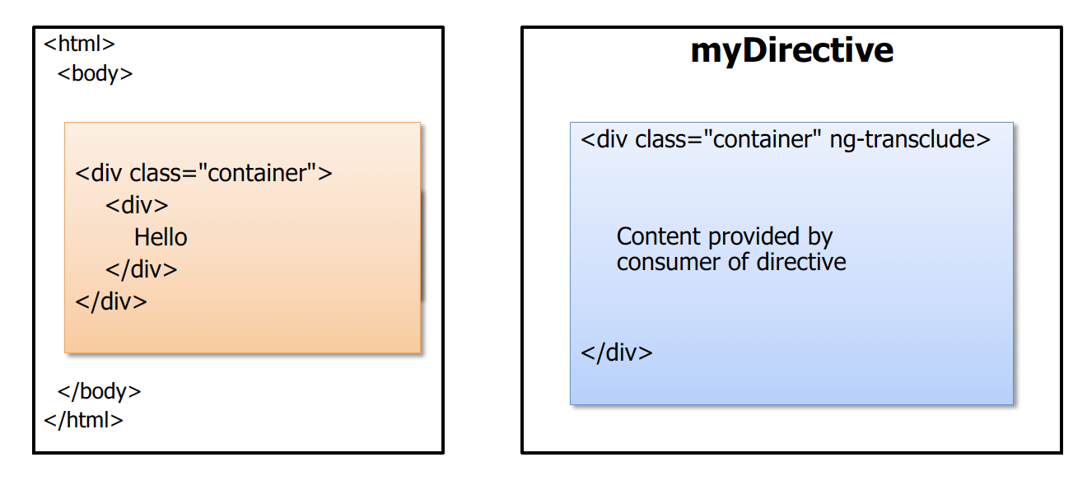
Understanding Transclusion
  Using Transclusion

Slide 14
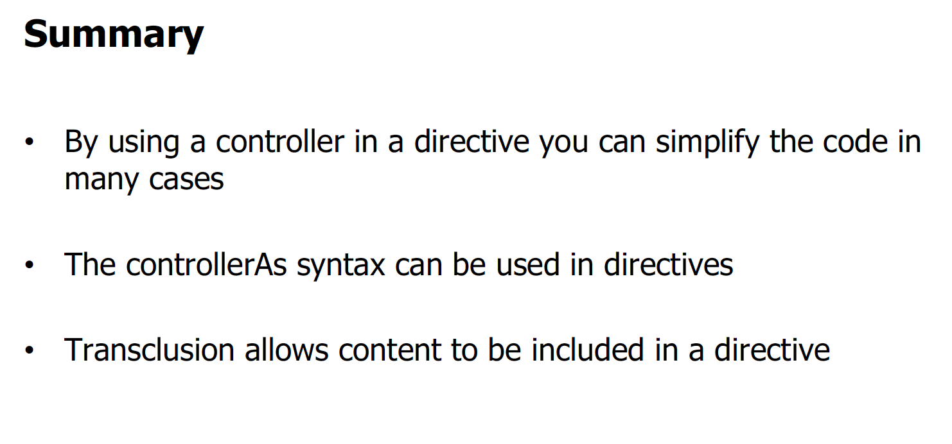
Using a Controller in a Directive

